Slide 1
AWS Cloud Practitioner Tutorial

Slide 2
AWS Tutorial Topics to Cover
1. AWS Fundamentals
- Introduction to AWS
- AWS Global Infrastructure (Regions, Availability Zones, Edge Locations)
- AWS Free Tier and Account Setup
- Understanding IAM (Identity and Access Management)
- AWS CLI and SDKs (for Java, Python, etc.)
2. Storage & Databases
- S3 (Simple Storage Service)
- Buckets, Permissions, Lifecycle Policies
- Static Website Hosting
- Versioning, Encryption
- RDS (Relational Database Service)
- MySQL, PostgreSQL, Oracle, MSSQL
- Multi-AZ & Read Replicas
- DynamoDB (NoSQL Database)
- Amazon Aurora (High-performance database)
3. Compute Services
- EC2 (Elastic Compute Cloud)
- Launching, Configuring, and Managing EC2 instances
- Key Pairs & SSH Access
- Security Groups & Networking
- Load Balancing (ELB)
- Auto Scaling
- Lambda (Serverless Computing)
- Writing AWS Lambda functions (Java, Node.js, Python)
- Event-driven architecture
- API Gateway + Lambda
- Elastic Beanstalk (PaaS for Java, Node.js, etc.)
- ECS (Elastic Container Service) and EKS (Kubernetes on AWS) 4. Networking & Security
- VPC (Virtual Private Cloud)
- Subnets, Route Tables, Internet & NAT Gateways
- VPC Peering, VPN, Direct Connect
- Security Services
- AWS IAM Roles & Policies
- AWS KMS (Key Management Service)
- AWS WAF (Web Application Firewall)
- AWS Shield (DDoS Protection)

Slide 3
AWS Tutorial Topics to Cover
5. CI/CD & DevOps on AWS
- CodeCommit (Git-based repository)
- CodeBuild (Build Automation)
- CodeDeploy (Deployment Automation)
- CodePipeline (CI/CD Pipelines)
- CloudFormation (Infrastructure as Code)
- Terraform with AWS (for Infrastructure Automation)
- Monitoring & Logging
- CloudWatch (Logs, Metrics, Alarms)
- AWS X-Ray (Distributed Tracing)
- AWS Config & CloudTrail
6. AWS API & Messaging Services
- API Gateway (Creating RESTful APIs)
- SNS (Simple Notification Service)
- SQS (Simple Queue Service)
- EventBridge
7. Serverless & Microservices
- Deploying Spring Boot Microservices on AWS
- Containerizing Java Apps using Docker & ECS
- Using AWS Lambda for Serverless Microservices
8. AWS Advanced Topics (Optional but Recommended)
- AWS Step Functions (Workflow Automation)
- AWS Glue (ETL for Big Data)
- AWS Athena (Serverless SQL Queries)
- AWS Redshift (Data Warehousing)
- AWS Cost Optimization Strategies
How This Relates to Java Full Stack & DevOps?
- Deploy Spring Boot backend on EC2, ECS, or Lambda
- Store data in RDS or DynamoDB
- Expose REST APIs via API Gateway
- Manage user authentication via IAM & Cognito
- Set up CI/CD Pipelines using CodePipeline & Jenkins
- Use Terraform for Infrastructure as Code
- Monitor applications using CloudWatch & X-Ray

Slide 4
What is AWS Cloud?
AWS (Amazon Web Services) is a cloud computing platform.
The first product (S3) was released in 2006.
AWS has grown a lot since then in both size and product range.
It is, to date, the largest cloud provider in the world.
Why Learn AWS?
AWS is the leading cloud provider with a global presence.
AWS skills are in high demand, offering great career opportunities.
It allows you to build, deploy, and manage almost any application.
A large community and extensive support resources make learning easier.
Features of AWS
Flexibility – AWS supports different operating systems, programming languages, and tools, making it easy to use.
Cost-effective – You only pay for what you use, with no upfront costs (you don't need to pay in advance for resources), reducing expenses.
Scalable and Elastic – AWS can automatically adjust resources to handle changes in demand.
Secure – It provides strong security features like encryption and access control to protect data.
Experienced – AWS has been in the cloud industry for years, ensuring reliable and efficient services.

Slide 5
What is AWS Cloud?
AWS (Amazon Web Services) is a cloud computing platform.
The first product (S3) was released in 2006.
AWS has grown a lot since then in both size and product range.
It is, to date, the largest cloud provider in the world.
Why Learn AWS?
AWS is the leading cloud provider with a global presence.
AWS skills are in high demand, offering great career opportunities.
It allows you to build, deploy, and manage almost any application.
A large community and extensive support resources make learning easier.
Features of AWS
Flexibility – AWS supports different operating systems, programming languages, and tools, making it easy to use.
Cost-effective – You only pay for what you use, with no upfront costs (you don't need to pay in advance for resources), reducing expenses.
Scalable and Elastic – AWS can automatically adjust resources to handle changes in demand.
Secure – It provides strong security features like encryption and access control to protect data.
Experienced – AWS has been in the cloud industry for years, ensuring reliable and efficient services.

Slide 6
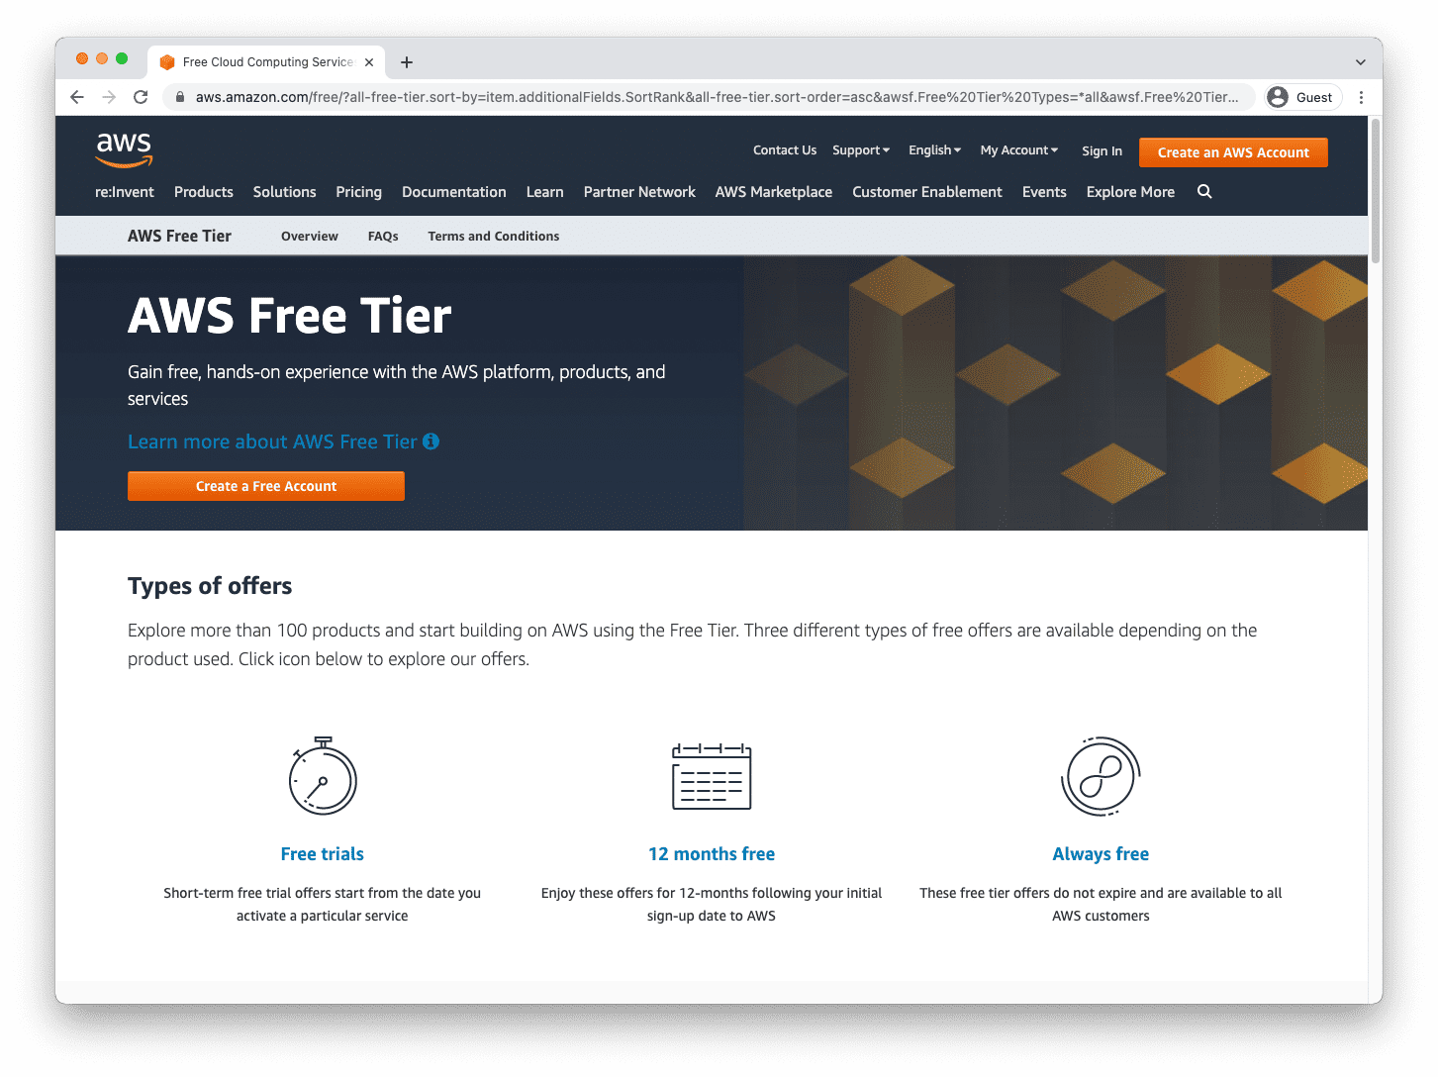
AWS Cloud Get Started Free AWS Account AWS offers a free tier, letting you explore and try out their services. The free tier offers you limited use of services for free. So let us get started with creating your free account!
How To Sign Up
Step 1: Go to the AWS website to get your free account: Sign up for free

Slide 7
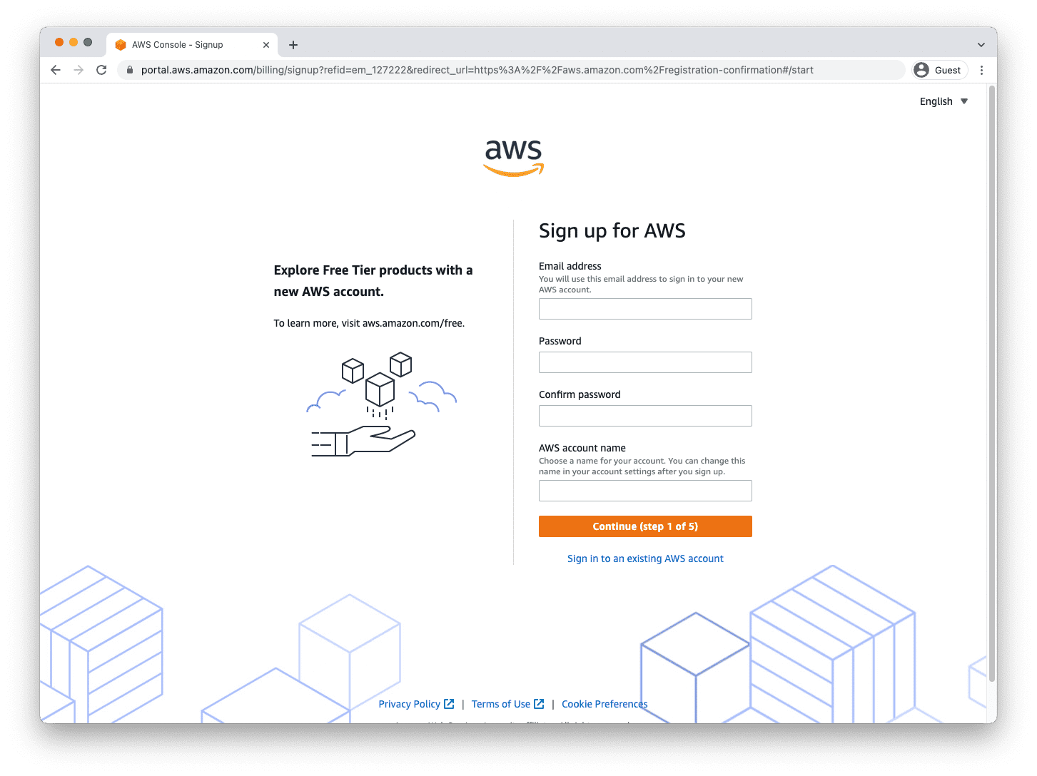
Step 2: Click the "Create a free account" button.

Slide 8
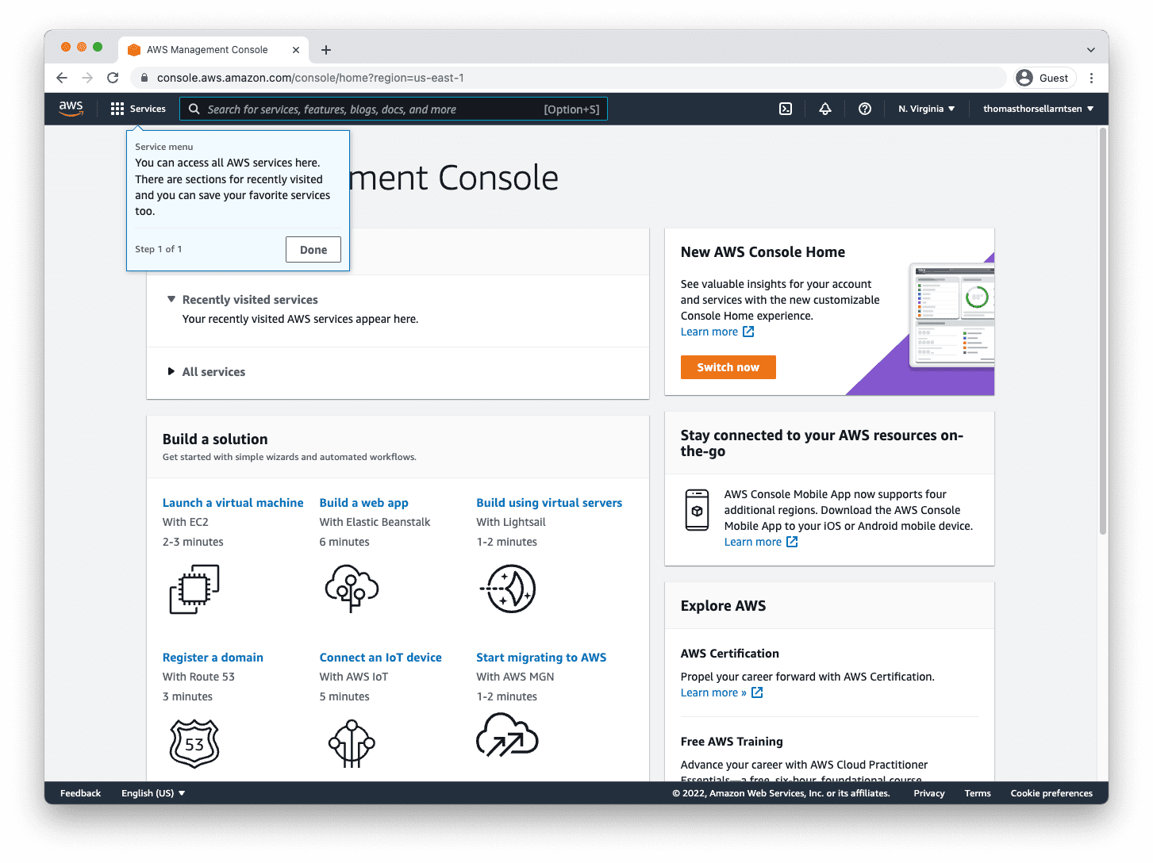
Step 3: Complete the registration steps.

Slide 9
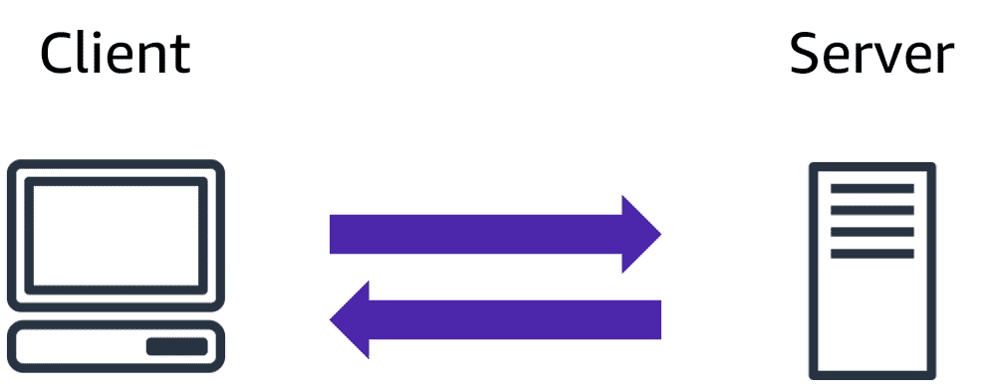
AWS Cloud Computing
The Client-Server Model
The client-server model is a key concept in cloud computing, where multiple clients access services from a centralized server.
What is the Client-Server Model?
The client-server model consists of a client that sends requests to a server, which processes the requests and returns the required information.
The client is the interface through which a user interacts with the server.
The server performs tasks, manages resources, and responds to client requests efficiently.

Slide 10
What is Cloud Computing?
Cloud computing is a technology that provides computing services over the internet, including storage, servers, databases, networking, and software.
It follows a pay-as-you-go model, meaning you only pay for the resources you use, reducing costs and improving flexibility.
Deployment Models
Cloud computing can be deployed in three different ways:
1. Cloud-Based Deployment
All resources (servers, databases, networking) are hosted in the cloud.
Suitable for businesses looking to build new applications or migrate existing ones.
Different cloud services offer varying levels of control and management.
Example: A company builds a mobile app and deploys it entirely on AWS, Microsoft Azure, or Google Cloud. Users access the app via the internet, while the backend runs on cloud servers, storing data in a cloud database. (Netflix, Spotify, Zoom)
2. On-Premises Deployment (Private Cloud)
Resources are managed within an organization's own data center.
Uses virtualization and resource management tools for efficiency.
Ideal for businesses that require full control over their infrastructure.
Example: A bank or government organization that handles sensitive data runs its own private cloud within a secured data center. All customer transactions and records remain on-premises for security and compliance. (Bank of America, PayPal, NASA)
3. Hybrid Deployment
Combines cloud-based and on-premises infrastructure.
Useful for organizations handling sensitive data or following strict regulations.
Offers flexibility by keeping critical workloads on-premises while using cloud resources for scalability.
Example: A healthcare provider stores sensitive patient records on-premises but uses cloud-based AI services for medical research and analytics. This ensures compliance with regulations while benefiting from cloud computing power. (Amazon, Dropbox, Tesla)

Slide 11
AWS Cloud Benefits
Why Choose Cloud Computing?
Cloud computing offers businesses and individuals a flexible, cost-effective, and scalable way to manage IT resources without heavy infrastructure investments.
Key Benefits of Cloud Computing:
Cost Savings – No need for costly data centers; pay only for what you use.
Security – Cloud providers offer encryption, compliance, and security measures.
Scalability – Easily increase or decrease resources based on demand.
Flexibility – Access applications and data from anywhere, anytime.
Payment Model and Efficiency:
The pay-as-you-go model eliminates upfront costs and financial risks.
Reduces operational overhead by removing the need for infrastructure management.
Ensures efficient resource allocation, preventing over-provisioning or wastage.
Innovation and Global Reach:
Enables rapid development, testing, and deployment of applications.
Provides instant resource availability, allowing businesses to scale quickly.
Global cloud infrastructure reduces latency and improves application performance.
Cloud computing helps businesses focus on innovation while reducing costs and operational complexity.

Slide 12
AWS IAM (Identity and Access Management)
What is AWS IAM?
AWS IAM is a security service that controls who can access AWS resources and what actions they can perform. It helps manage users, groups, roles, and permissions securely.
What is AWS SAML?
AWS SAML (Security Assertion Markup Language) allows users to log in to AWS using their organization's identity provider (SSO – Single Sign-On).
Types of AWS SAML:
AWS as a Service Provider (SP) – AWS allows users to log in using an external identity provider (e.g., Google, Okta, or Microsoft). The identity provider authenticates the user, and AWS grants access based on assigned permissions. (SSO – Single Sign-On).
AWS as an Identity Provider (IdP) – AWS itself acts as the authentication system for third-party applications. Users can log in to external applications using their AWS credentials.
Advantages of AWS SAML:
Allows users to access AWS without creating separate credentials.
Enhances security with centralized user authentication.
Simplifies access management for large organizations.
IAM Identities
IAM provides different identities to manage access:
Users – Individual AWS accounts with assigned permissions.
Groups – Collections of users with shared permissions.
Roles – Temporary access permissions assigned to users or services.
IAM Roles
IAM roles grant temporary permissions to users, applications, or AWS services. Unlike users, roles don’t have permanent credentials.
IAM Roles Use Cases
EC2 Instance Access – Assign roles to EC2 instances to access AWS resources securely.
Cross-Account Access – Allow users from another AWS account to access resources.
AWS Service Roles – Grant AWS services permissions to interact with other AWS resources.
Federated Access – Enable users to log in using external identity providers like Google, Microsoft, or Okta.

Slide 13
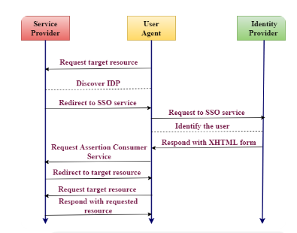
Working of SAML (Security Assertion Markup Language)
Step-by-Step Explanation with Example : 1. User Requests Target Resource
The user enters `mail.google.com` (Gmail) in their web browser.
Gmail (Service Provider - SP) checks if the user is already authenticated.
2. Service Provider Discovers the Identity Provider (IdP)
Gmail detects that Google is the Identity Provider (IdP)responsible for authentication.
3. Redirect to SSO Service
Gmail redirects the user’s browser to Google's SSO login page(`accounts.google.com`).
4. Identity Provider Handles Authentication
Google asks the user to log in with their credentials (email & password).
If the user is already logged in, this step is skipped.
5. IdP Responds with an XHTML Form
After successful login, Google sends an authentication response(in SAML format) back to the browser.
The browser automatically submits this XHTML form to Gmail’s Assertion Consumer Service (ACS).
6. Request Assertion Consumer Service (ACS)
Gmail receives the authentication token from Google and verifies it.
7. Redirect to Target Resource
Once verified, Gmail redirects the user back to their inbox.
8. User Requests Target Resource Again
The user now requests their inbox data.
9. Service Provider Responds with the Requested Resource
Gmail displays the inbox, and the user can access their emails.

Slide 14
IAM Identities in AWS (briefly)
IAM Identities in AWS
AWS IAM (Identity and Access Management) provides different identities to manage access to AWS resources securely. These identities help in assigning permissions based on roles and responsibilities.
1. IAM Users
An IAM User represents an individual person or application that needs access to AWS. Each user has unique credentials (password or access keys) and assigned permissions.
Example: A developer needs access to AWS EC2 and S3, so an IAM User is created with appropriate permissions.
2. IAM Groups
A Group is a collection of IAM Users with the same set of permissions. Instead of assigning permissions to each user individually, you assign them to a group.
Example: A company creates a "Developers" group that has access to AWS Code Commit or approvals for Merge Requests and EC2, and all developers are added to this group.
3. IAM Roles
A Role is a temporary set of permissions that users or services can assume. Unlike users, roles don’t have long-term credentials (passwords or access keys). Instead, AWS provides temporary security credentials when a role is assumed.
Example: An EC2 instance needs access to an S3 bucket, so an IAM Role is assigned to the instance, allowing it to access the bucket securely without storing credentials.
IAM identities help control and secure AWS resources efficiently while ensuring users and services have only the necessary permissions.

Slide 15
Creating IAM Roles
Creating IAM Roles for a Service Creating a Role for a Service Using the AWS Management Console
1. Open the AWS IAM Console: https://console.aws.amazon.com/iam/
2. In the navigation pane, click Roles and then click Create Role.
3. Choose the AWS service that will use the role.
4. Select the managed policy that attaches the permissions to the service.
5. Enter a Role Name and click Create Role to complete the process. Creating a Role for a Service Using the AWS CLI
1. Create a role:
command : aws iam create-role --role-name <role-name> --assume-role-policy-document file://<policy-document>.json
2. Attach a permission policy:
command : aws iam put-role-policy --role-name <role-name> --policy-name <policy-name> --policy-document file://<policy-document>.json
3. If the role is for an EC2 instance, create an instance profile:
command1 : aws iam create-instance-profile --instance-profile-name <profile-name> command2 : aws iam add-role-to-instance-profile --instance-profile-name <profile-name> --role-name <role-name>

Slide 16
Creating IAM Roles
Creating IAM Roles for an IAM User
Creating a Role for an IAM User Using the AWS Management Console
1. Open the AWS IAM Console and go to Roles > Create Role.
2. Specify the account ID that you want to grant access to.
3. If needed, select:
- Require External ID (for third-party users).
- Require MFA (for multi-factor authentication).
4. Attach a permission policy to the role.
5. Enter a Role Name and click Create Role.
Creating a Role for an IAM User Using AWS CLI
1. Create a role:
command : aws iam create-role --role-name <role-name> --assume-role-policy-document file://<policy-document>.json
2. Attach a permission policy:
command : aws iam put-role-policy --role-name <role-name> --policy-name <policy-name> --policy-document file://<policy-document>.json

Slide 17
Creating IAM Roles
Creating IAM Roles for a Third-Party Identity Provider (Federation)
Web Identity Federation
1. Open the AWS IAM Console and go to Roles > Create Role.
2. Choose Web Identity as the trusted entity type.
3. Specify the client ID or identity pool ID for your application.
4. (Optional) Add conditions for access.
5. Attach a permission policy and complete the role creation.
SAML 2.0 Federation
1. Open the AWS IAM Console and go to Roles > Create Role.
2. Choose Role for Identity Provider Access.
3. Select whether the role is for SSO or API access.
4. Select the SAML Provider and configure attributes if needed.
5. Attach a permission policy and complete the role creation.
Creating a Role for Federated Users Using AWS CLI
1. Create a role:
command : aws iam create-role --role-name <role-name> --assume-role-policy-document file://<policy-document>.json
2. Attach a permission policy:
command : aws iam attach-role-policy --role-name <role-name> --policy-arn <policy-arn>

Slide 18
AWS S3 - Simple Storage Service
What is S3?
- AWS S3 is a secure, scalable, and durable object storage service.
- It allows storing and retrieving any type of data such as images, PDFs, backups, and videos.
- Object-based storage means it does not function as a traditional file system.
- Supports unlimited storage, with each file size ranging from 0 bytes to 5 TB.
- Files are stored in buckets, which work like folders.
- Bucket names must be globally unique since they form a part of the public URL.
Key Components of S3
- Key: Unique identifier for an object (e.g., `file.txt`).
- Value: Actual data stored in S3 (e.g., text, image, video).
- Version ID: Unique identifier for different versions of an object.
- Metadata: Additional information about an object (e.g., content type, owner).
- Subresources: Stores object-specific settings such as permissions and policies.
- Access Control: Defines who can access the bucket or files.
Advantages of Amazon S3
- Buckets for Data Storage: Logical containers to store and manage files.
- Unlimited Storage: Store as many objects as needed.
- Accessibility: Retrieve files anytime, from anywhere.
- Security: Supports encryption, IAM policies, and access control lists.
- Scalability: Automatically scales based on demand.
- Standard APIs: Works with REST and SOAP APIs for integrations.
Use Cases for Java Full Stack & DevOps
- Host Static Websites: Store React/Angular frontend apps.
- Backup & Log Storage: Store logs, database snapshots, and archives.
- CI/CD Pipelines: Store build artifacts for deployment automation.
- Microservices Integration: Java Spring Boot applications can use S3 for file storage.

Slide 19
Amazon S3 Concepts
Amazon S3 (Simple Storage Service) is an object storage service designed for scalability, durability, and high availability. Below are the key concepts:
1. Buckets
A bucket is a container for storing objects.
Each object is stored within a single bucket .
Example: If an object named `photos/tree.jpg` is stored in the `treeimage` bucket, it can be accessed using: http://treeimage.s3.amazonaws.com/photos/tree.jpg
Buckets have unlimited storage capacity but cannot contain other buckets.
Performance remains consistent regardless of the number of buckets.
Only the AWS account owner can delete the bucket.
2. Objects
Objects are the actual files stored in S3.
Each object consists of:
Object Data (the actual content).
Metadata (name-value pairs like content type, last modified date).
Version ID (if versioning is enabled).
3. Keys
A key is a unique identifier for an object within a bucket.
Every object in a bucket has a unique key .
Example: http://jtp.s3.amazonaws.com/2019-01-31/Amazons3.wsdl
Bucket Name: `jtp`
Key: `2019-01-31/Amazons3.wsdl`
4. Regions
S3 allows users to choose a geographical region to store their data.
Choosing the right region helps:
Reduce latency
Minimize costs
Address regulatory requirements
Objects do not move across regions unless explicitly transferred.
5. Data Consistency Model
S3 ensures high availability by replicating data across multiple servers .
Read-After-Write Consistency (for New Objects)
When a new object is stored, it is immediately available for reading .
Listing the objects in a bucket reflects the new object immediately.
Eventual Consistency (for Updates & Deletes)
When an object is updated or deleted , changes take time to propagate .
Example:
A process updates an object , but if another process tries to read it immediately, old data may still appear.
If an object is deleted , listing the objects may still show the deleted object for a short time.

Slide 20
**Creating an S3 Bucket**
**Step 1: Access S3 in AWS Console**
- Sign in to the **AWS Management Console**.
- Navigate to **S3 Services** from the AWS dashboard.
**Step 2: Create a New Bucket**
- Click on **"Create bucket"**.
- Enter a **unique bucket name** (must follow DNS naming rules).
- Select a **region** for storing data.
- Click on **"Create"** to finalize.
- Buckets and objects are **private by default**.
**Step 3: Upload a File**
- Click on your created bucket.
- Click **"Upload" → "Add files"** and select a file (e.g., `jtp.jpg`).
- Click **"Upload"** to add it to the bucket.
**Step 4: Access the Uploaded File**
- Click on the uploaded **object** and copy its **Object URL**.
- By default, the object **is not publicly accessible**.
**Step 5: Make Object Public (Optional)**
- To allow public access:
1. Modify **Bucket Permissions**.
2. Go to **"Actions" → "Make public"**.
3. Confirm changes.
4. Now, the object URL will be accessible publicly.
**Key Points to Remember**
- **Buckets have a globally unique name** (universal namespace).
- **Successful uploads return HTTP 200 status code**.
- **Storage Classes:** S3 Standard, S3-IA, Reduced Redundancy Storage.
- **Encryption:** Client-Side & Server-Side Encryption available.
- **Access Control:** Managed via ACLs or **Bucket Policies**.
- **By default, buckets & objects are private**.

Slide 21
AWS S3 Storage Classes
aws s3 storage classes are different types of cloud storage designed to optimize cost, availability, durability, and performance based on how frequently data is accessed.
each storage class is suited for a specific use case, from frequently accessed data to long-term archival storage.
why do we need storage classes ?
- cost optimization by using cheaper storage for infrequent data
- durability and redundancy to protect against data loss
- performance flexibility with instant or delayed retrieval options
- automatic lifecycle management to move data between classes based on usage
- 1. S3 Standard
- Designed for frequently accessed data with high availability (99.99%) and durability (99.999999999%).
- Stores data across multiple availability zones to ensure redundancy and prevent data loss.
- Default storage class if no specific class is assigned during upload.
- 2. S3 Standard-IA (Infrequent Access)
- Suitable for data that is not accessed often but still needs quick retrieval when needed.
- Cheaper than S3 Standard but has retrieval fees.
- Requires objects to be stored for at least 30 days.
- Stores data across multiple availability zones for durability.
- 3. S3 One Zone-IA
- Costs 20% less than Standard-IA because it stores data in only one availability zone.
- Suitable for backups or easily re-creatable data, but has a risk of data loss if the availability zone fails.
- Requires objects to be stored for at least 30 days and has retrieval fees.
- 4. S3 Glacier (Archival Storage)
- Best for long-term storage of rarely accessed data at the lowest cost.
- Designed for archival purposes, with retrieval times depending on the selected option:
- Expedited: Available in minutes (higher cost).
- Standard: Available in 3-5 hours.
- Bulk: Available in 5-12 hours (lowest cost).
- Requires objects to be stored for at least 90 days.
- **Lifecycle Management**
- Helps reduce storage costs by automatically moving objects to cheaper storage classes as they become less frequently accessed.
- Ideal for data retention policies and long-term cost savings.

Slide 22
AWS S3 Versioning:
Versioning in S3 helps store multiple versions of an object in the same bucket, allowing recovery from accidental overwrites or deletions.
**How Versioning Works – Step-by-Step Example**
**1. Enable Versioning in S3**
1. Open **AWS Management Console** → Go to **S3**.
2. Select or **create a bucket**.
3. Navigate to **Properties** → Find **Versioning**.
4. Click **Edit**, select **Enable**, and save changes.
**2. Upload an Object (First Version)**
- Upload a file named **document.txt** to the bucket.
- The file gets stored with a **version ID** (e.g., **v1**).
**3. Upload a New Version (Overwrite the File)**
- Re-upload **document.txt** with modified content.
- Instead of replacing the old file, S3 **creates a new version** (e.g., **v2**).
- The old version is still stored and can be accessed.
**4. Delete an Object**
- Delete **document.txt** from the bucket.
- Instead of removing the file, S3 adds a **delete marker**.
- The file appears deleted, but older versions still exist.
**5. Restore a Deleted Object**
- Click **Show versions** in S3 bucket.
- Find the **delete marker** and delete it.
- The latest version of **document.txt** is restored.
**Key Points to Remember**
- **All versions of an object are stored** – even deleted ones.
- **Once enabled, versioning cannot be disabled**, only suspended.
- **Older versions can be retrieved anytime**.
- **MFA Delete** provides extra security by requiring multi-factor authentication for deletions.
- **Lifecycle rules** can automatically delete or transition older versions to cheaper storage.
This makes versioning a powerful tool for **data recovery, backups, and protection against accidental deletions**.

Slide 23
**AWS S3 Cross Region Replication (CRR)**
Cross Region Replication (CRR) is an **Amazon S3 feature** that automatically copies objects from one S3 bucket (source) to another (destination) in a different AWS region.
This helps in **data backup, disaster recovery, compliance, and reducing latency** for users in different locations.
**Steps to Enable Cross Region Replication:**
1. **Create Two Buckets**
- One as the **source** and another as the **destination**, each in a different AWS region.
2. **Enable Versioning**
- Both buckets must have **versioning enabled** (CRR does not work without it).
3. **Go to Management Tab**
- In the **source bucket**, navigate to **Replication Rules**.
4. **Set Up a Replication Rule**
- Click **"Get Started"**, choose whether to **replicate the entire bucket** or only specific objects (using tags).
5. **Select Destination Bucket**
- Choose the **destination bucket** where objects will be copied.
6. **Create IAM Role**
- Assign an **IAM role** with the necessary permissions for S3 to replicate objects. 7. **Save and Apply the Rule**
- Once saved, new objects uploaded to the source bucket will be **automatically** replicated.
**Key Points to Remember:**
- Existing objects before enabling replication will not be copied automatically (use AWS CLI to copy them manually).
- Delete markers and deleted versions are not replicated.
- Replication is asynchronous, meaning there may be a delay before objects appear in the destination bucket.
- Each source bucket can replicate only to one destination bucket.
- AWS encrypts data in transit between regions using SSL.
**Use Cases of Cross Region Replication:**
1. **Compliance & Data Residency**
- Store copies of data in specific regions to meet regulatory requirements.
2. **Disaster Recovery**
- Ensure data is available in another region in case of failures.
3. **Reducing Latency**
- Maintain copies in multiple regions for faster access by users in different locations.
4. **Cross-Account Replication**
- Transfer ownership of replicated objects to a different AWS account.
This helps in **data protection, availability, and performance optimization** across AWS regions.

Slide 24
**AWS S3 Lifecycle Management**
**Definition:**
AWS S3 Lifecycle Management automates the transition of objects between different storage classes and enables automatic expiration of objects to optimize storage costs.
**Key Features:**
- Transition objects to lower-cost storage tiers (e.g., Standard IA, Glacier).
- Automatically delete objects after a specified period.
- Applies to both current and previous versions of objects.
- Reduces storage costs by moving infrequently accessed data to cheaper tiers.
**Example Lifecycle Policy:**
- Day 0: Store objects in Standard storage.
- Day 30: Transition objects to Standard-IA (lower-cost storage).
- Day 60: Move objects to Glacier (long-term archival).
- Day 425: Expire/Delete objects automatically.
Steps to Configure S3 Lifecycle Policy:**
1. Sign in to AWS Management Console.
2. Go to S3, create or select a bucket.
3. Navigate to the Management tab.
4. Click "Create lifecycle rule" and enter a rule name.
5. Set transition rules (e.g., move to Standard IA after 30 days, Glacier after 60 days).
6. Define expiration policy (e.g., delete objects after 425 days).
7. Review and save the lifecycle rule.
**Outcome:**
- Efficient storage management.
- Reduced storage costs.
- Automated data retention and archival.

Slide 25
Amazon CloudFront (CDN)
What is it:
CloudFront is a Content Delivery Network that helps deliver content (like websites, images, and videos) faster to users by using a network of Edge Locations located globally.
How it works:
1. User sends a request.
2. CloudFront checks if the content is already cached in the nearest Edge Location.
3. If cached, it's delivered immediately.
4. If not cached, CloudFront fetches it from the origin (like S3 or EC2), stores it at the edge location, and then serves it.
5. Future users get the cached content, which makes delivery faster.
Important terms:
- Edge Location: Data center that caches content.
- Origin: The source of your content (S3, EC2, etc.).
- Distribution: A CloudFront setup to deliver content. Two types:
- Web Distribution: Used for websites and web content.
- RTMP Distribution: Used for streaming media (deprecated now).
**Steps to Create AWS CloudFront Distribution**
1. **Upload Files to S3**
- Create an S3 bucket (e.g., `my-static-site-bucket`)
- Upload files (e.g., `index.html`, `style.css`)
- Set public access OR use **Origin Access Control (OAC)** for private access
2. **Open CloudFront Console**
- Go to **CloudFront > Create Distribution**
3. **Configure Origin**
- Set **Origin Domain**: your S3 bucket URL
- Enable OAC if S3 is private
- (Optional) Add **Origin Path** if using subfolders
4. **Set Cache Behavior**
- **Viewer Protocol Policy**: Redirect HTTP to HTTPS
- **Allowed Methods**: GET, HEAD (default for static)
- **Caching**: Use origin headers or define TTLs
5. **Distribution Settings**
- **Default Root Object**: `index.html`
- **Price Class**: Choose based on region/cost
- **SSL**: Use default or custom ACM cert
- (Optional) Enable logging
6. **Create Distribution**
- Wait a few minutes for deployment
- Use generated URL (e.g., `d123abc4xyz.cloudfront.net`)
7. **Access & Test**
- Open `https://<CloudFrontDomain>/index.html`
- (Optional) Map custom domain via Route 53 + SSL

Slide 26
AWS Storage Gateway
What is it:
Storage Gateway is a hybrid cloud storage service that allows you to connect your on-premises environment to AWS. It helps with backup, archiving, and disaster recovery.
Types of gateways:
1. File Gateway
- Used for storing files like documents and PDFs to S3.
- Supports NFS protocol.
- Data is stored as S3 objects.
- Common use cases: file backups, archiving, and hybrid apps.
2. Volume Gateway
- Used for storing block-based data.
- Uses iSCSI protocol.
- Data is stored in EBS snapshots.
- Two types:
a. Stored Volumes: Entire dataset is stored locally, with backups to AWS.
b. Cached Volumes: Only frequently accessed data is stored locally. All data is in AWS.
3. Tape Gateway
- Used for backup applications that use tape-based workflows.
- Replaces physical tapes with virtual tapes stored in S3 and Glacier.
- Supports major backup software like Veeam and NetBackup.
- Uses iSCSI protocol.
Security and performance:
- Can connect through Direct Connect or VPC.
- Uses EBS snapshots for durability.
- Encrypts data in transit and at rest.

Slide 27
**AWS Snow Family**
1. **AWS Snowball**
- Used to transfer large amounts of data (e.g., 80TB) into/out of AWS using a physical device.
- Example: If you have 500TB of data and slow internet, you can request a Snowball, load the data, and ship it to AWS.
- Benefits: Fast, secure (256-bit encryption), cost-effective, avoids internet transfer.
2. **AWS Snowball Edge**
- 100TB storage device with compute power.
- Can run Lambda functions and has S3, EC2-compatible endpoints.
- Example: Aircraft manufacturers collect engine data mid-flight and send it to AWS after landing.
- Supports clustering for higher durability and local processing.
3. **AWS Snowmobile**
- For very large data (up to 100PB) transfers using a truck with a 45-foot container.
- Used for full data center migrations.
- Secure
**S3 Transfer Acceleration – Explained**
- **What is it?**
A feature in Amazon S3 that helps you upload and download files faster from anywhere in the world.
- **How it works:**
Instead of sending data directly to an S3 bucket, your data first goes to the **nearest AWS edge location** (from the CloudFront network).
Then, AWS sends it securely and quickly to your S3 bucket using its fast internal network.
- **When to use it:**
- You have users in different countries uploading files.
- Your app needs faster upload/download performance.
- Your internet speed is slow or has high latency to the S3 region.
- **Example:**
Suppose your S3 bucket is in **US-East (Ohio)**, and you are uploading a file from **India**.
With Transfer Acceleration, the file first goes to the nearest AWS edge location (in Mumbai), then AWS sends it to the US S3 bucket internally.
- **How to enable it:**
1. Go to your S3 bucket in AWS Console.
2. Open **Properties** → find **Transfer Acceleration**.
3. Enable it.
4. Use the new URL: `your-bucket-name.s3-accelerate.amazonaws.com`
- **Pricing:**
Transfer Acceleration has extra cost, based on the data size and source location.

Slide 28
**1. AWS EC2**
EC2 (Elastic Compute Cloud) is a virtual server in the cloud. It allows you to run applications like you would on a physical computer. You can choose the size, memory, and operating system. It is highly scalable and flexible.
**Example**: Hosting a web application using an Ubuntu EC2 instance.
**Actions**:
- Go to EC2 Dashboard
- Click "Launch Instance"
- Select OS and configuration
- Launch with key pair
**2. AWS EBS**
EBS (Elastic Block Store) provides storage volumes that can be attached to EC2 instances. It works like a hard drive and stores data even after the instance is stopped.
**Example**: Store files or database data on a 100GB EBS volume.
**Actions**:
- Go to EC2 → Volumes
- Click “Create Volume”
- Attach to EC2 instance
- Mount and use the disk
**3. Creating an EC2 Instance**
Steps to launch a virtual server in the cloud.
**Example**: Launch a free-tier EC2 instance for learning Linux.
**Actions**:
- Go to EC2 Dashboard → Launch Instance
- Choose AMI (e.g. Ubuntu)
- Choose type (e.g. t2.micro)
- Configure storage and security group
- Launch using key pair
**4. EBS Volume**
A block-level disk attached to EC2. Can be used for persistent data.
**Example**: Create a separate volume for log files.
**Actions**:
- Create a new EBS Volume
- Attach it to an instance
- Log into EC2 and format the volume
- Mount it using `mount` command

Slide 29
**5. Security Group**
Acts as a virtual firewall for EC2. Allows or blocks traffic based on rules.
**Example**: Allow only port 22 (SSH) and port 80 (HTTP) for web access.
**Actions**:
- Go to Security Groups
- Create or edit one
- Add inbound rules (e.g., allow SSH from your IP)
- Assign to EC2 instance
**6. AWS AMI**
AMI (Amazon Machine Image) is a ready-to-use OS and software bundle for launching EC2.
**Example**: Use Amazon Linux AMI to launch a web server.
**Actions**:
- Choose AMI during EC2 creation
- Use public AMI or Marketplace AMI
- Launch EC2 with it
**7. Creating an AMI**
Used to save the configuration of an EC2 for future use.
**Example**: Create an AMI from a configured EC2 with installed software.
**Actions**:
- Go to EC2 → Instances
- Right-click → Create Image
- Provide image name
- Use to launch identical EC2 instances later
**8. AWS Load Balancing**
Distributes traffic across multiple EC2 instances. Improves performance and uptime.
**Example**: Distribute website visitors across 3 EC2 instances.
**Actions**:
- Go to EC2 → Load Balancers
- Create Load Balancer
- Configure listeners (like HTTP 80)
- Register EC2 instances

Slide 30
**9. Creating Load Balancer**
Set up rules and targets for traffic balancing.
**Example**: Application Load Balancer for a web app.
**Actions**:
- Choose Application Load Balancer
- Set name, listeners, and availability zones
- Create target group and register EC2 instances
Review and launch
**10. AWS Lambda**
Lambda allows running code without managing servers. You pay only for run time.
**Example**: Automatically resize images uploaded to S3.
**Actions**:
- Go to Lambda Console
- Click “Create Function”
- Choose Python or Node.js
- Add S3 trigger
- Deploy function
**11. Creating a Lambda**
Steps to create a function that runs based on triggers.
**Example**: Send welcome email when a new user signs up.
**Actions**:
- Go to Lambda → Create Function
- Choose author from scratch
- Write or upload code
- Set trigger (e.g., API Gateway or S3)
- Test and monitor
**12. CloudWatch EC2**
Monitors EC2 metrics like CPU, memory, disk, and sends alerts.
**Example**: Alert when CPU usage > 80%.
**Actions**:
- Go to CloudWatch Console
- Select EC2 metrics
- Create Alarm
- Set threshold and notification
**13. AWS Bash Script**
Used to automate tasks during EC2 launch like installing software.
**Example**: Install Apache during EC2 launch.
**Actions**:
- Create a script:
```bash
#!/bin/bash
yum update -y
yum install httpd -y
systemctl start httpd
systemctl enable httpd
```
- Paste in “User Data” while launching EC2
- Script runs automatically after launch

Slide 31
**What is DNS and How It Works**
DNS stands for Domain Name System.
DNS changes website names like www.google.com into IP addresses like 192.168.1.1 that computers understand.
IP addresses are used by computers to find each other on the internet.
There are two types of IP addresses: IPv4 and IPv6.
Each domain name is made of parts separated by dots.
The last part is called the top-level domain (TLD). Examples: .com, .org, .edu
The part before that is the second-level domain. For example, in google.com, .com is the top-level and google is the second-level domain.
In .co.uk, .uk is the top-level and .co is second-level.
Top-level domains are managed by IANA (Internet Assigned Numbers Authority).
IANA keeps a list of all valid TLDs. You can see this list at: http://www.iana.org/domains/root/db
Domain names must be unique. That is why there are domain registrars.
A domain registrar is a company that gives domain names to people.
Popular registrars are GoDaddy, Namecheap, and 123-reg.
All domain names are stored in a central database called the WHOIS database.
**DNS Records and Key Terms**
SOA Record (Start of Authority)
It holds important info about the DNS zone.
Includes the main server's name, the admin’s email, version of zone data, and time-to-live (TTL).
TTL means how long the DNS record is kept before checking for updates. Lower TTL makes updates faster.
NS Record (Name Server)
This tells which DNS server has the actual DNS records.
Example: If someone asks for hindi100.com, and their DNS does not know it, it checks .com TLD, finds the NS record (like ns.awsdns.com), then goes to that name server to get the IP.
A Record (Address Record)
Maps a domain name to an IP address.
Example: www.javatpoint.com → 123.10.10.80
TTL (Time to Live)
This shows how long a DNS record is saved (cached).
Shorter TTL = faster updates.
CNAME Record (Canonical Name)
Points one domain to another.
Example: mobile.devices.com → m.devices.com
Alias Record
Similar to CNAME but used for AWS services like Load Balancer, S3, or CloudFront.
Alias works for root domain (like example.com) while CNAME does not.

